Slide 1


USING CINEMA TO TRAIN HEALTH PROFESSIONALS TO DIAGNOSE ADDICTIVE DISORDERS
Daniele Zullino
Submission Number: 34575
WHO collaborating center

Slide 2
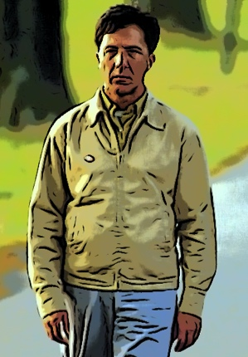
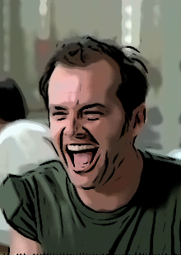
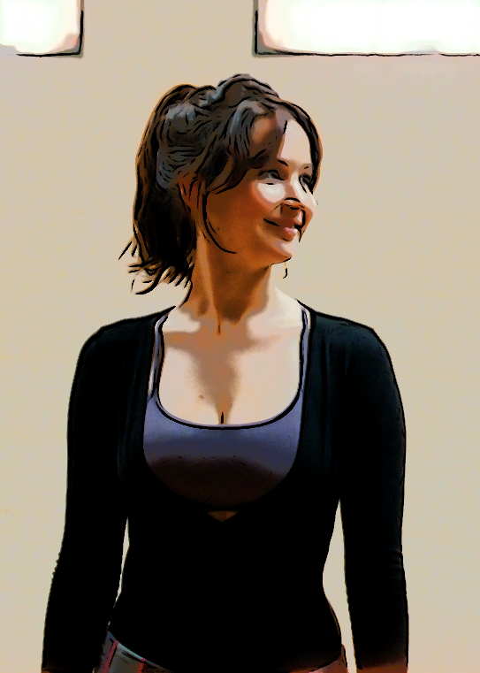
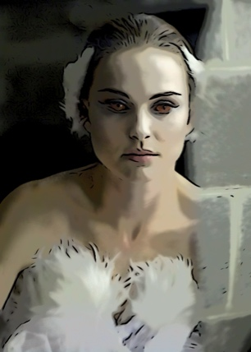
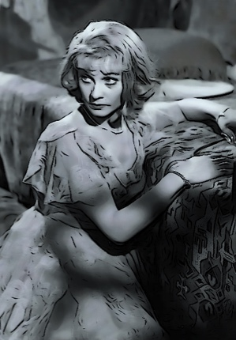
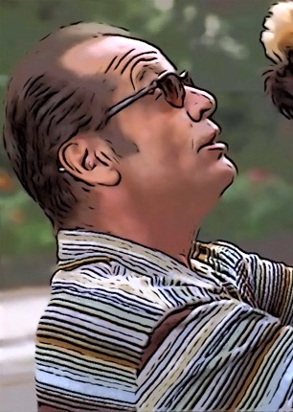
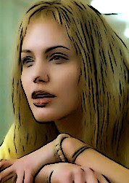

Mental illness and Academy Awards

Slide 3
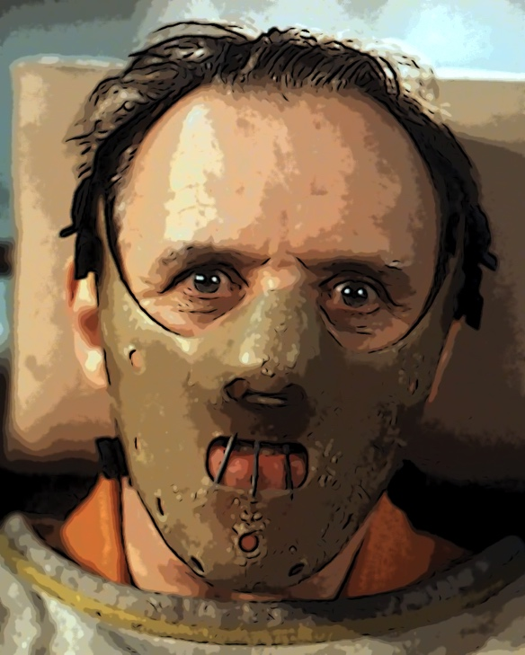
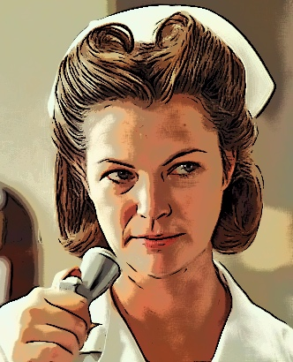
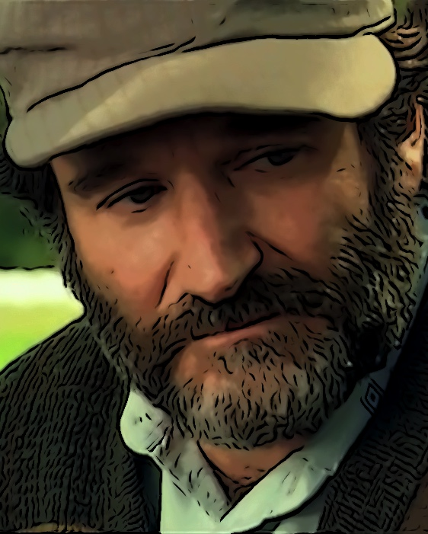
Mental Health Professional
and Academy Award

Slide 4

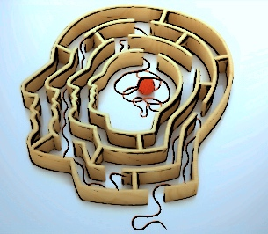
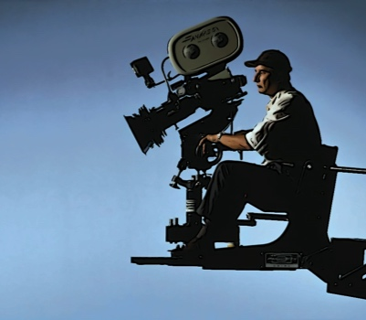

Psychiatry and film-making
seek to understand
characters
motivations
behaviors
relationships
life paths
“the human”

Slide 5
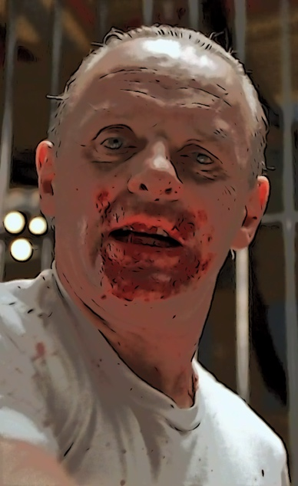

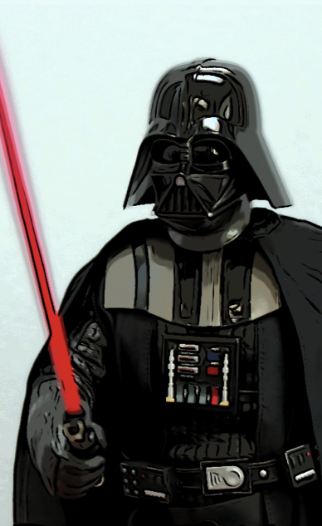
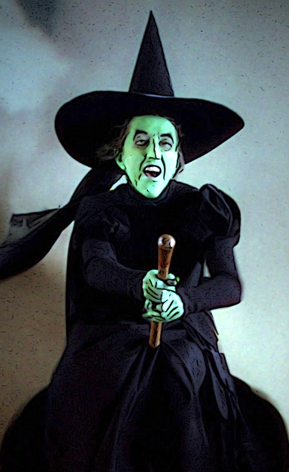
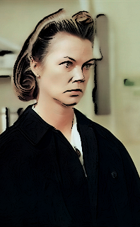
AFI - Top 5 screen villains of all time
1
2
3
4
5
Hannibal
Lecter
Norman
Bates
Darth
Vader
Wicked
Witch
Nurse
Ratched

Slide 6



Learning process
entertaining and enjoyable
Motivation
Effective learning

Slide 7
What film makes possible
Showing problems “in the situation”
e.g. drug injecting
Longitudinal nature of psychiatric diseases
psychopathological developments
Illustrate complex ideas in a short period of time
Show otherwise covert psychological phenomena
e.g. merging real and hallucinated perceptions, reality and delusions
transport the spectator to the protagonist’s childhood, to a different times and places in the past

Slide 8

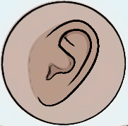
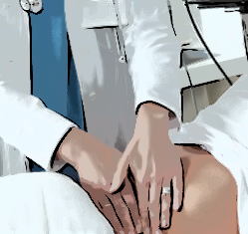
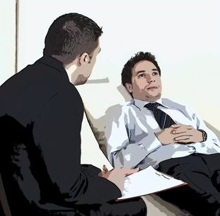

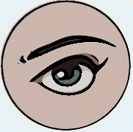



Slide 9
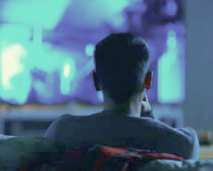
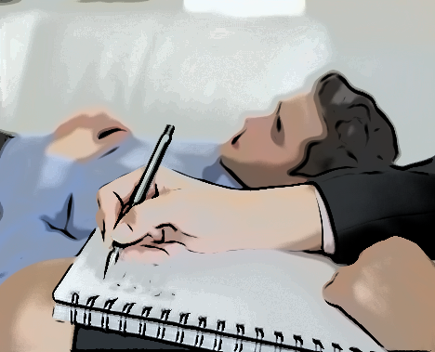
observing
listening
observing
listening
no problem
to ensure
Confidentiality ?

Slide 10
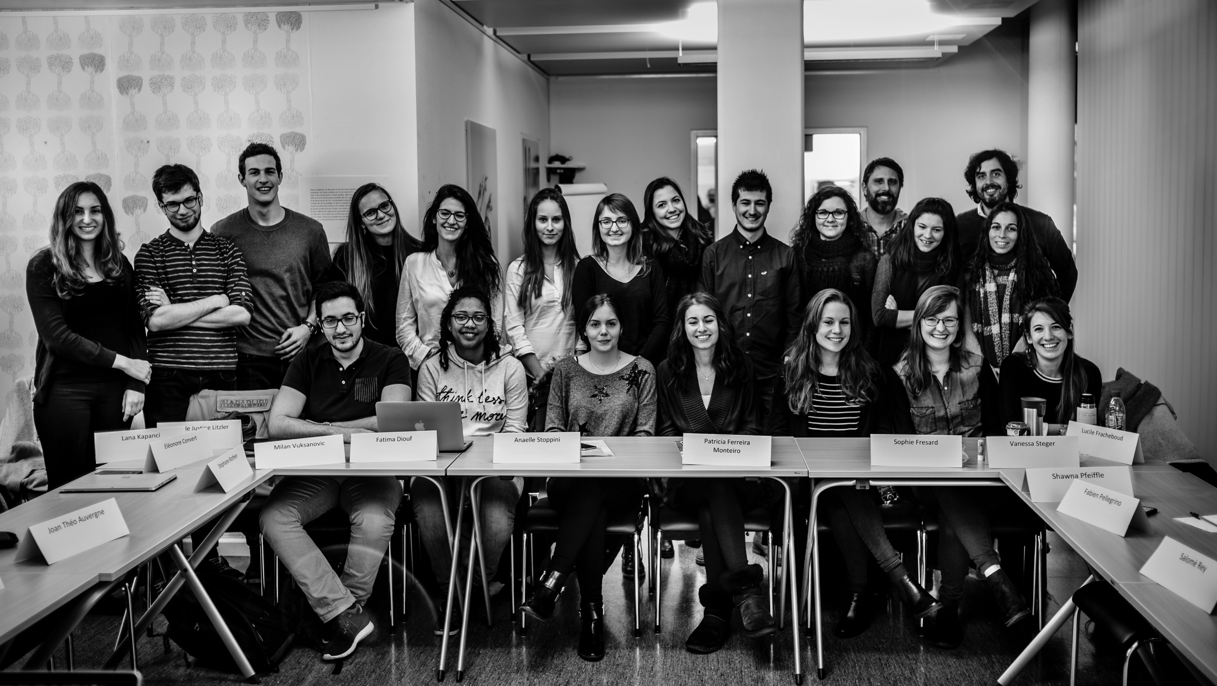

Slide 11
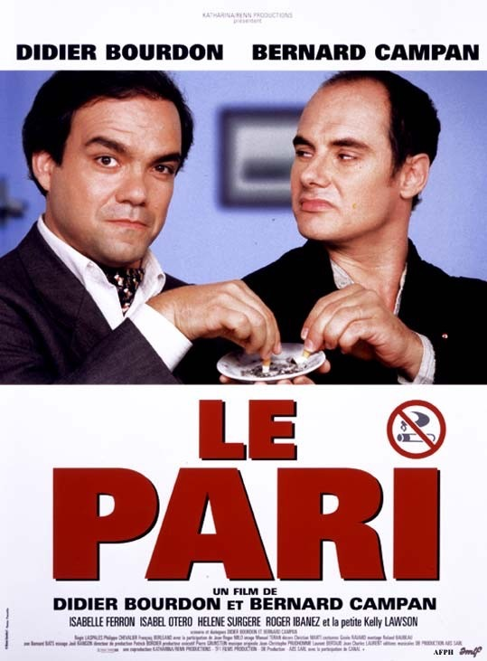



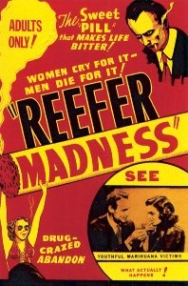




#1 | #2 | #3 | #4 | #5 | #6 | #7 | #8 | #9
OPIOID | ALCOHOL | STIMULANT | SEDATIVE | CANNABIS | HALLUCINOGENs | TOBACCO | GAMBLING | SEX

Slide 12
Fleiss' kappa
reliability of agreement between students
OPIOID | ALCOHOL | STIMULANT | SEDATIVE | CANNABIS | HALLUCINOGENs | TOBACCO
0.376*
0.474*
0.271*
0.154*
0.346*
0.335*
0.307*
* p < 0.05, i.e. Fleiss' kappa significantely better than chance.

Slide 13

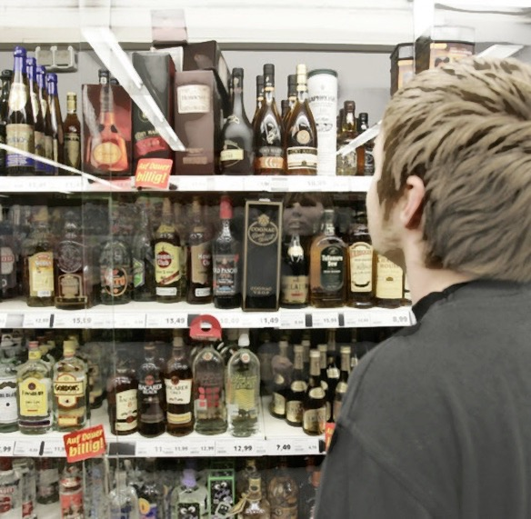
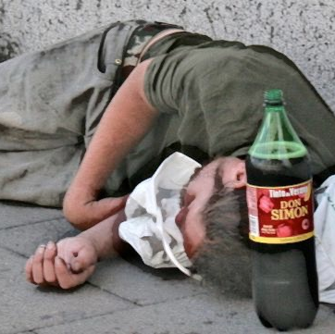
Central syndrome
addictive behavior
Secondary syndrome
consequences
little variance
large variance

Slide 14
core syndrome
secondary syndrome
tolerance
Chi² = 23.813, df = 1, p < 0.001

Slide 15
Conclusions
Psychiatry an interesting topic for movie makers
Mainstream movies interesting for training in psychiatry
engaging, motivating
illustration semiology, psychopathology
Mainstream movies suitable for psychiatry training

Slide 16






http://addictohug.ch/
https://www.facebook.com/addictologieHUG/
https://twitter.com/addictologiehug
https://www.linkedin.com/company/service-d'addictologie
https://www.youtube.com/channel/UCVhK2ZmXqSqWqR3rtgGHvpA/videos
http://www.hug-ge.ch/addictologie

