Slide 1
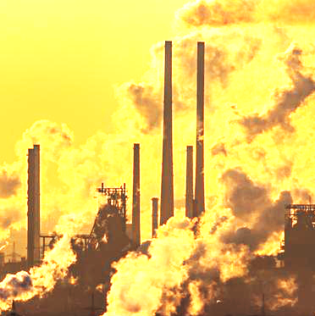
Addiction Is a Useful Model to Nurture the Development of Policy Measures for a Successful Transition Towards a Sustainable Development
Daniele Zullino, Camille Lefrançois-Coutant, Lolita Rubens, Jean-Christophe Seznec, Grażyna Wąsowicz
International Panel on Behavioral Change (IPBC)
WHO collaborating center

Slide 3
https://gieco-ipbc.org/en/

Slide 5
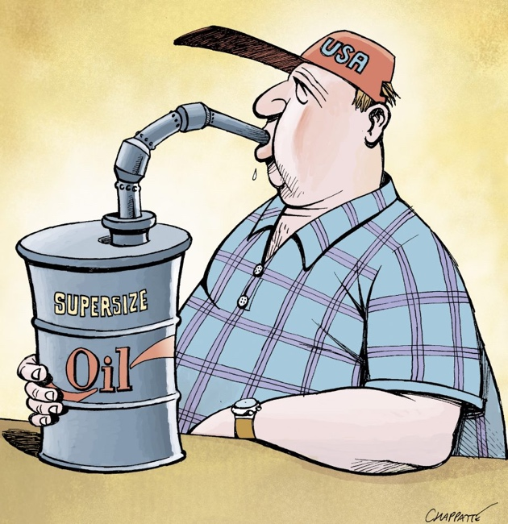

Slide 6
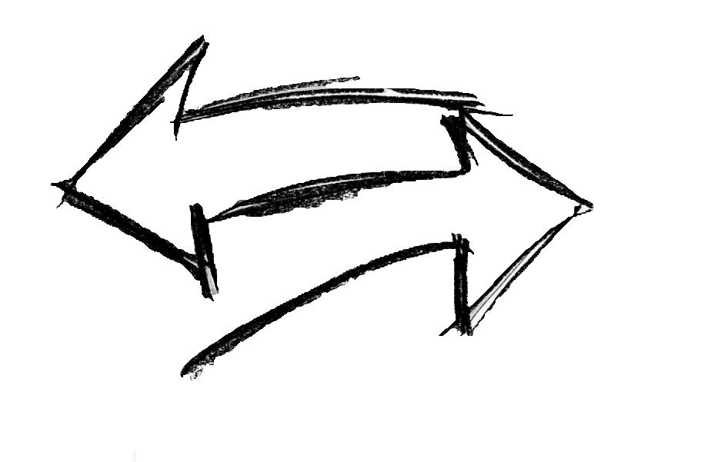
Clinical
Addiction
e.g. alcohol, opiates,
gambling
Public Health
Strategies
Environmentally damaging
behavior
Environmentally-relevant
policies

Slide 7
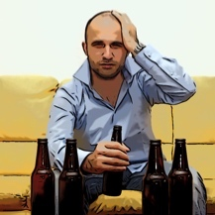
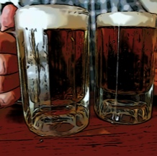
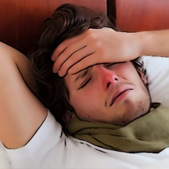
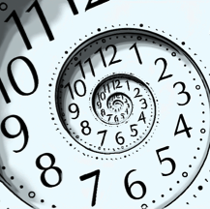
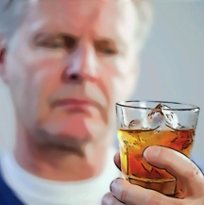
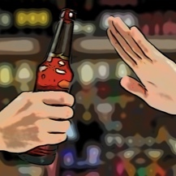
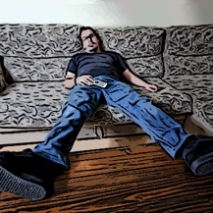
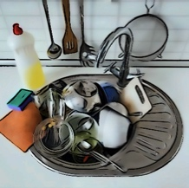
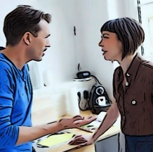
DSM 5 Criteria for Substance Use Disorders
Hazardous use
Larger amounts or for longer than meant to
Tolerance
Withdrawal symptoms
Excessive time investment
Cravings
Wanting to cut down, but not managing to
Neglect of social /
professional activities
Failure to fulfill the main obligations
Continued use despite awareness of a persistent problem
Continuous use despite persistent / recurring social or interpersonal problems

Slide 8
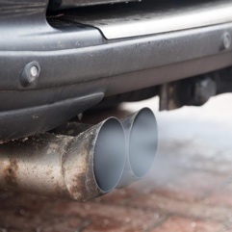
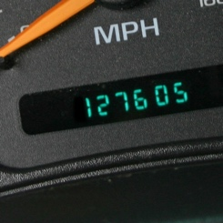
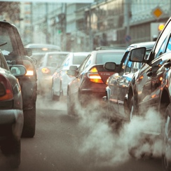
DSM 5 Criteria for SUV Use Disorders
Hazardous use
Larger amounts or for longer than meant to
Tolerance
Withdrawal symptoms
Excessive time investment
Cravings
Wanting to cut down, but not managing to
Continued use despite awareness of a persistent problem

Slide 9
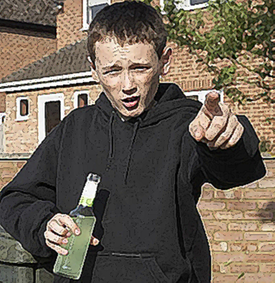
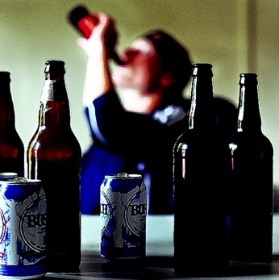
Natural history of addiction
Initiation
Hedonic use
Addiction
Context
Hedonic
effects
Automatization

Slide 10
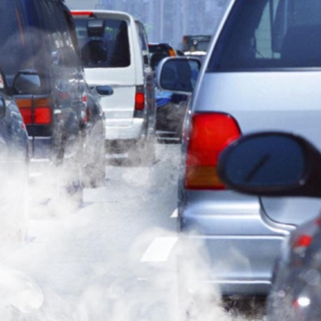
Natural history of addiction
Initiation
Hedonic use
Addiction
Context
Hedonic
effects
Automatization

Slide 11
What is addictive behavior
Disproportionate propensity to allocate behavior to the use of a product
Automatized consumption behavior triggered also in situation for which deliberative thinking would have launched a different behavior
Conflict between immediate objectives (attainted through typical addictive behavior) and long-term goals (related to tendentially in deliberative thinking) (Delay discounting)

Slide 12
automatic
deliberative
generated out of habit
generated in order to get desired outcomes
immediate objectives
long-term goals

Slide 13
Reflective Thinking
Rational Behavior
Behavior
Change
Interventions
Ressources
Climate
Environment
Non-reflective Thinking
Automatic Behavior

Slide 14
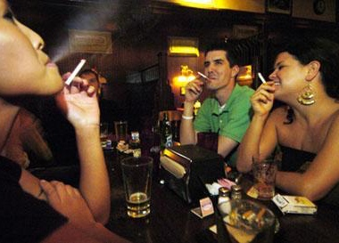
Shapes
BEHAVIOR
Social Monitoring
Social Pressure
Horne, 2003

Slide 15
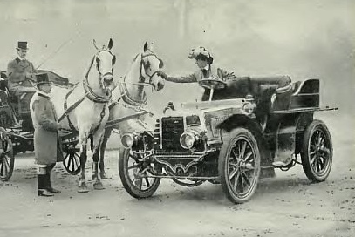
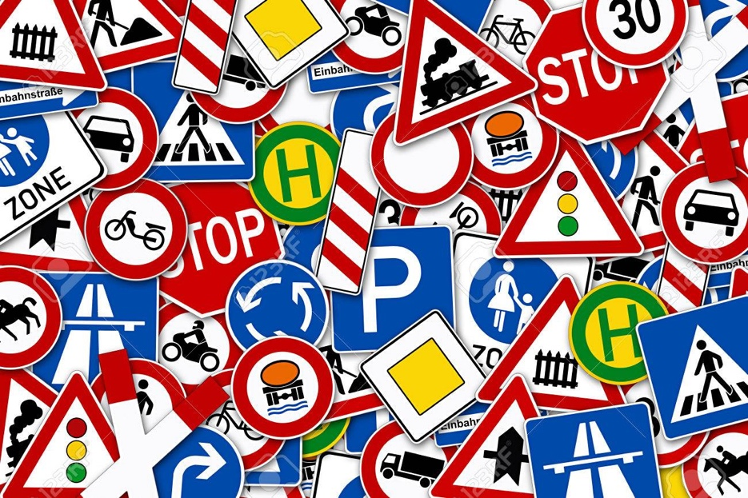
Cultural shifts
Policies

Slide 16
Objective of policies
Increase proclivity to deliberative processes
Without increasing undesirable circumventive behavior (black-market)

Slide 17
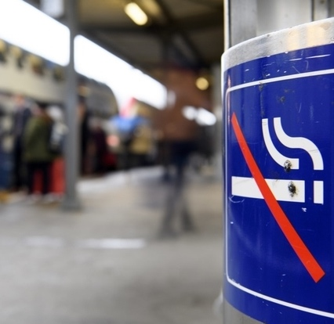
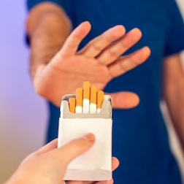
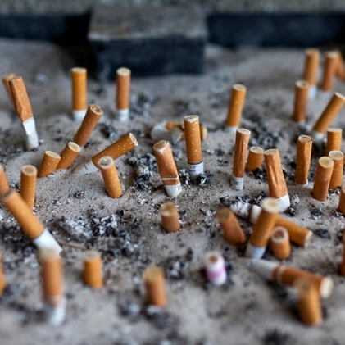
Smoke-free
public environments
Attitudes towards
smoking
↑ Quitting
↓ Initiation
↓ Relapse
↓ Prevalence
↓ Harmful outcomes
Kelly et al., 2018; Thomson et al., 2016; Fichtenberg and Glantz, 2002

Slide 18
Denormalization
a process
customary, acceptable, normal behaviors become considered as improper, unacceptable, discredited

Slide 19
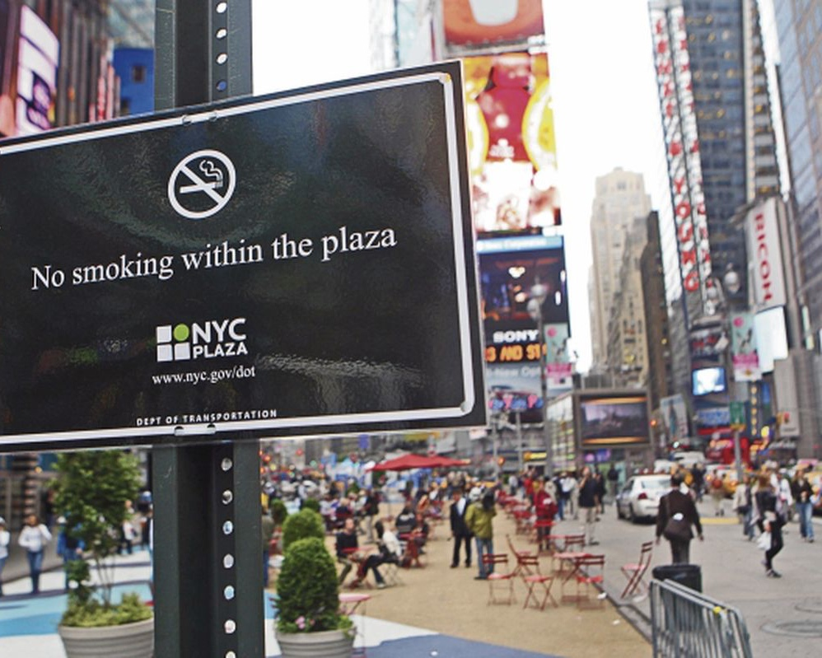
Denormalization and public spaces
Behavioral norms particularly strengthened through social practices occurring in public contexts
E.g. denormalization of smoking in public areas not limited to the spaces in which smoking bans apply
Kelly et al., 2018

Slide 20
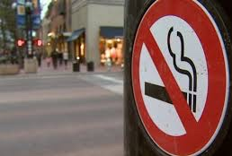
Denormalization and visibility
Denormalization
Normalization
Make the unwanted
invisible
Make the wanted
visible
Sæbø and Scheffels, 2017

Slide 21
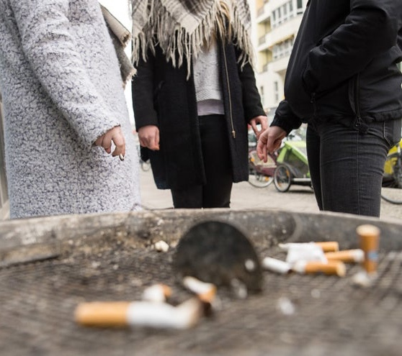
Denormalization and stigma
Denormalization approach is exceptional in that it endorses stigma rather than working to mitigate stigma
Stigmatization of smokers
→ ↓ care-seeking and social support
→ ↑ health and other inequities
Kelly et al., 2018; Lavack, 1999

Slide 22
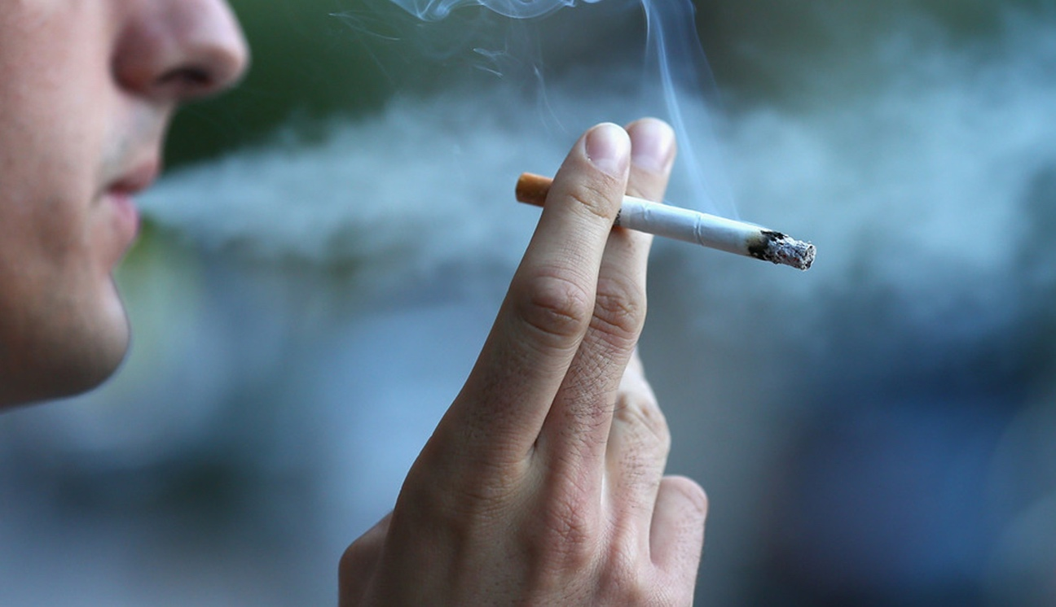
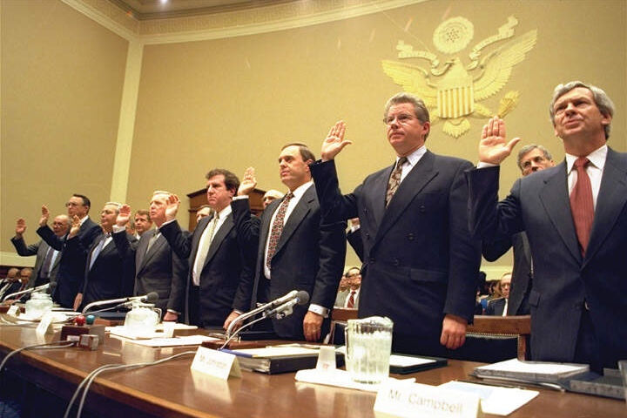
Denormalization
behavior
Denormalization
industry

Slide 23
Industry denormalization
Socially acceptable image one of the central themes of industry marketing
Industry denormalization
→ counteract the process of industry normalization
→ raise people’s awareness of the responsibility of the industry
→ expose the industry’s manipulative tactics
Hammond et al., 2006; Malone et al., 2012

Slide 24
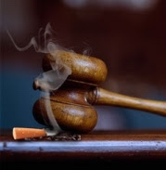
Effects of industry denormalization
Industry denormalization → ↑ support for government regulations
Beliefs about industry deceptiveness and support for counter-industry act → positively related to quit intentions
Malone et al., 2012; Hammond et al., 2006

Slide 25
Renormalization
denormalizing denormalization
advertising, sponsorship, advocacy, product placement
Sæbø and Scheffels, 2017

Slide 26
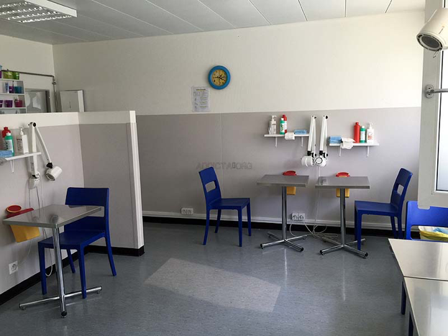
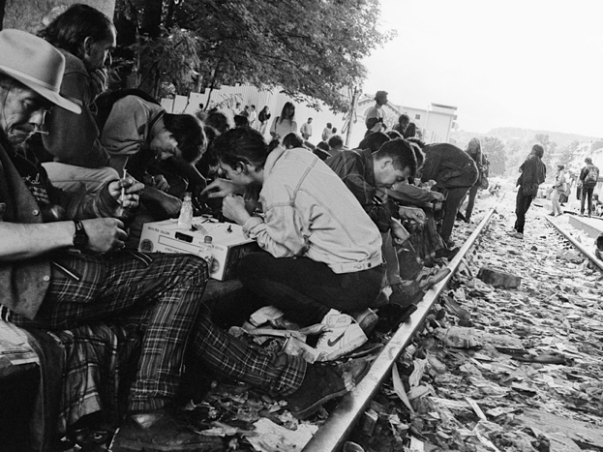
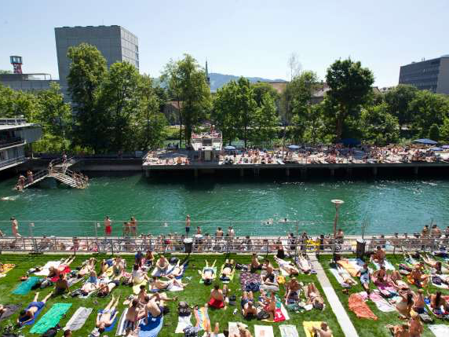
Denormalization always means also
normalization of alternatives
Principle of substitution-based
therapies!

Slide 27
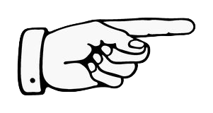
pro.addictohug.ch

Slide 28
https://gieco-ipbc.org/en/

