Slide 1
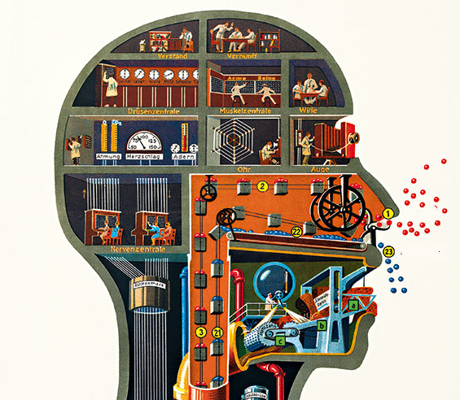
Anthropophagic Psychiatry
An Art Business
Daniele Zullino, Rodolphe Soulignac, Benedetto Saraceno, Judit Harangozo,
Gabriel Thorens, Gerard Calzada, Rita Manghi, Stéphane Rothen
Submission Number: 34489
WHO collaborating center

Slide 2
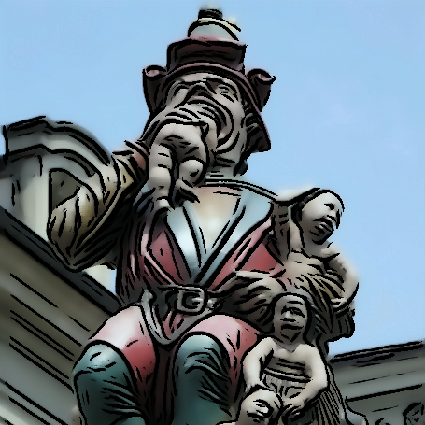
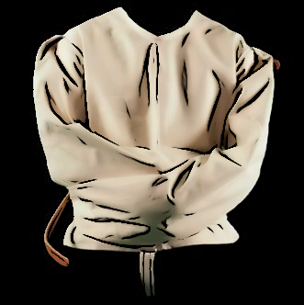
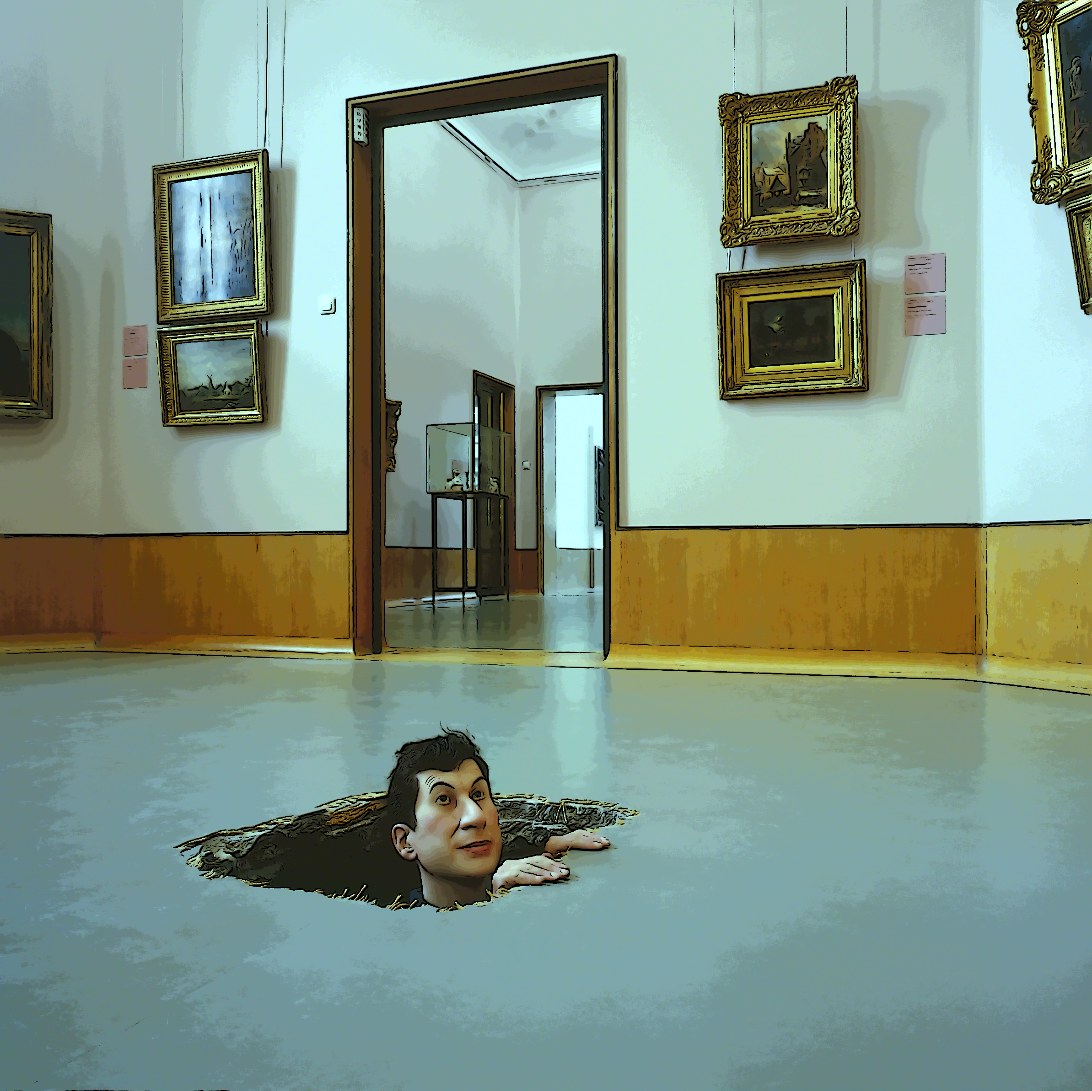
Agenda
Anthropoemia, anthropophagia
Psychiatry and deviance
The role of deviance … art

Slide 3
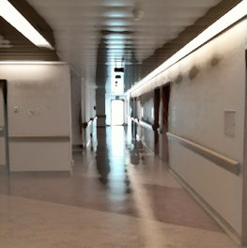
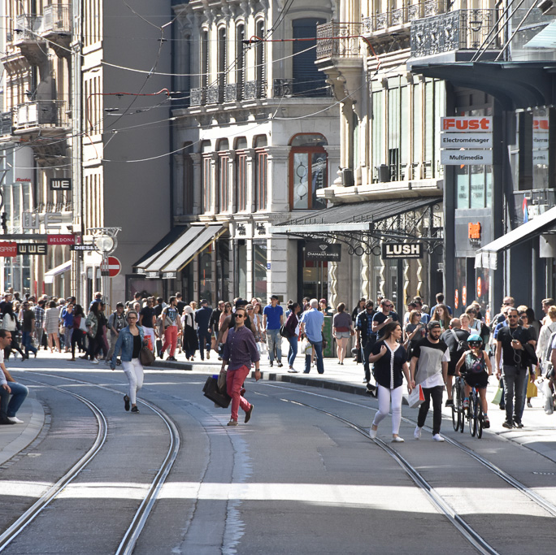
Contemporary dialectics in psychiatry
⇋
⇋
Hospital
Outpatient Facilities
Assertive Community
Treatment
Most time limited to discussion on resource allocation
➛ Fighting for resources rather than discussing about societal visions

Slide 4
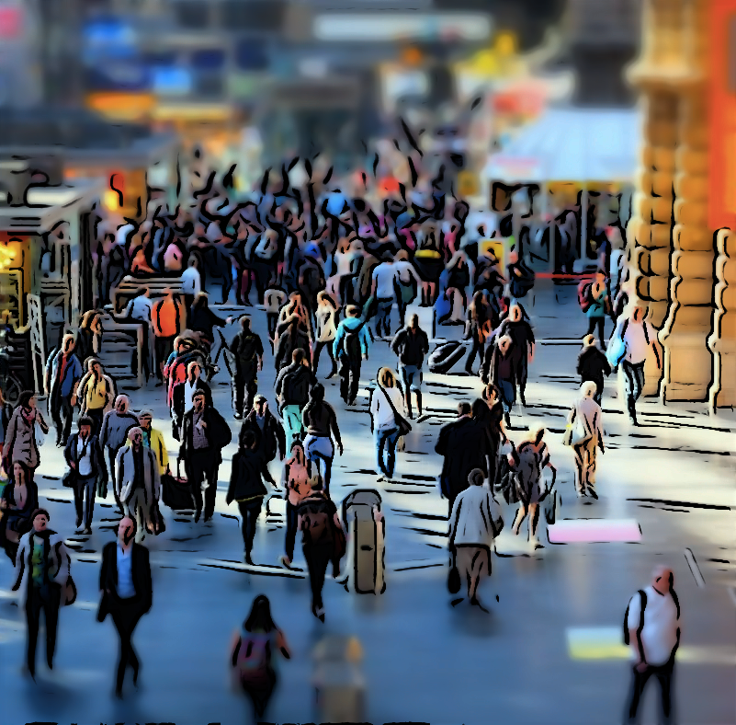
Structuralism
Elements of human culture must be understood in terms of their relationship to a larger, overarching system or structure
➛ uncover structures that underlie all the things that humans do, think, perceive, and feel

Slide 5
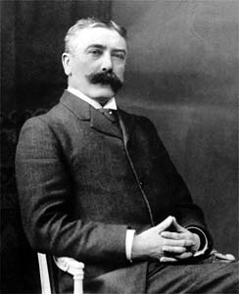
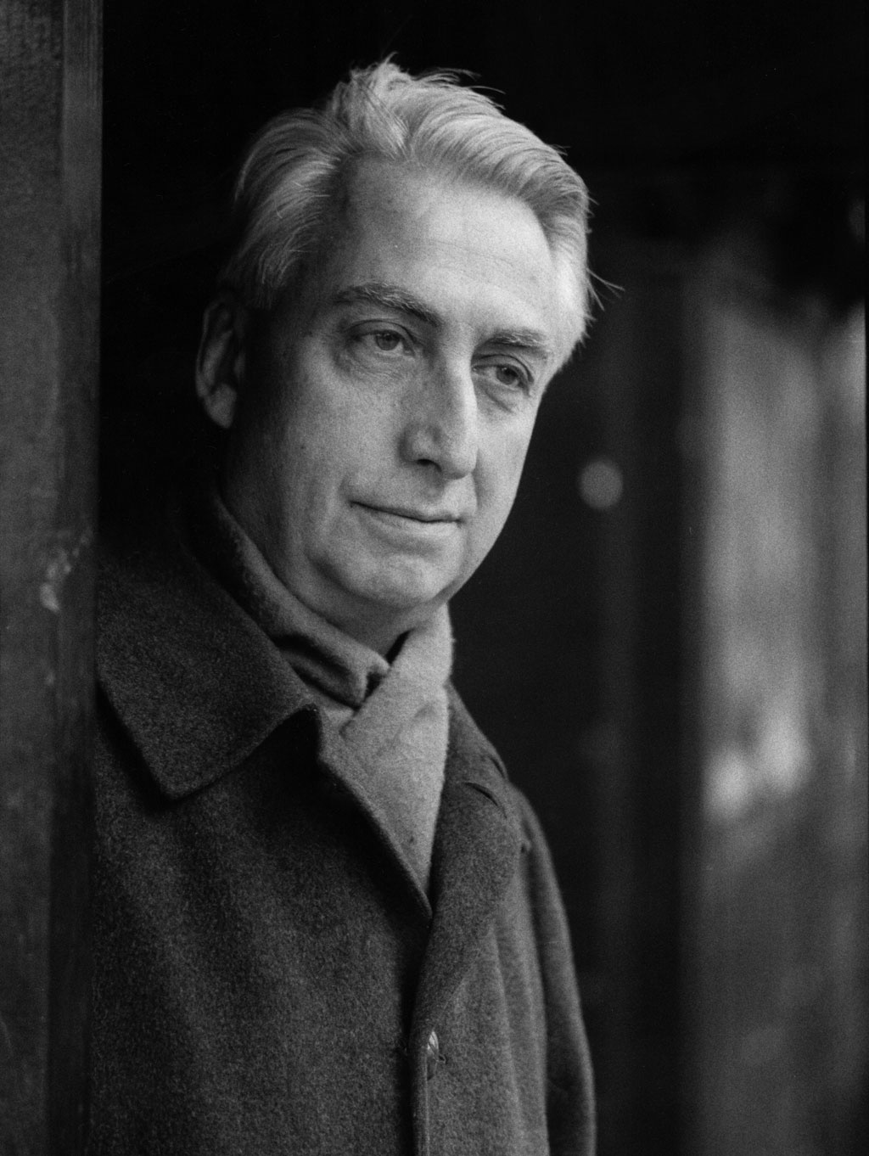
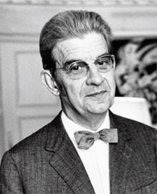
Structuralists
Ferdinand
de Saussure
linguistics
Roland
Barthes
literature
Jacques
Lacan
psychoanalysis
Claude
Levi-Strauss
anthropology

Slide 6
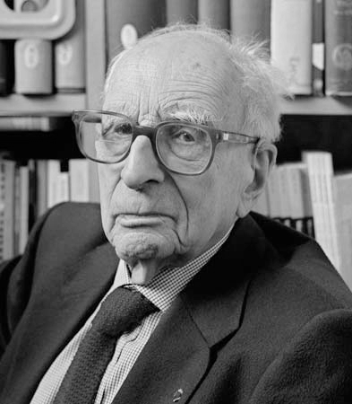
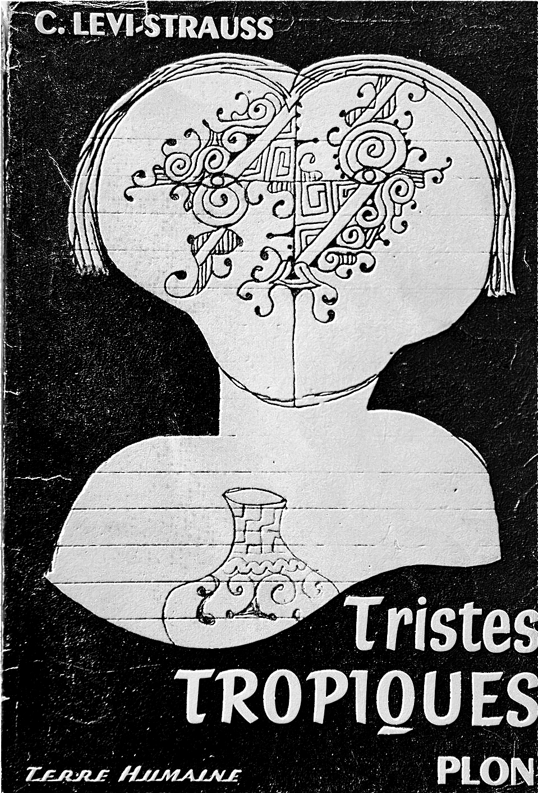
Claude Levy-Strauss

Slide 7
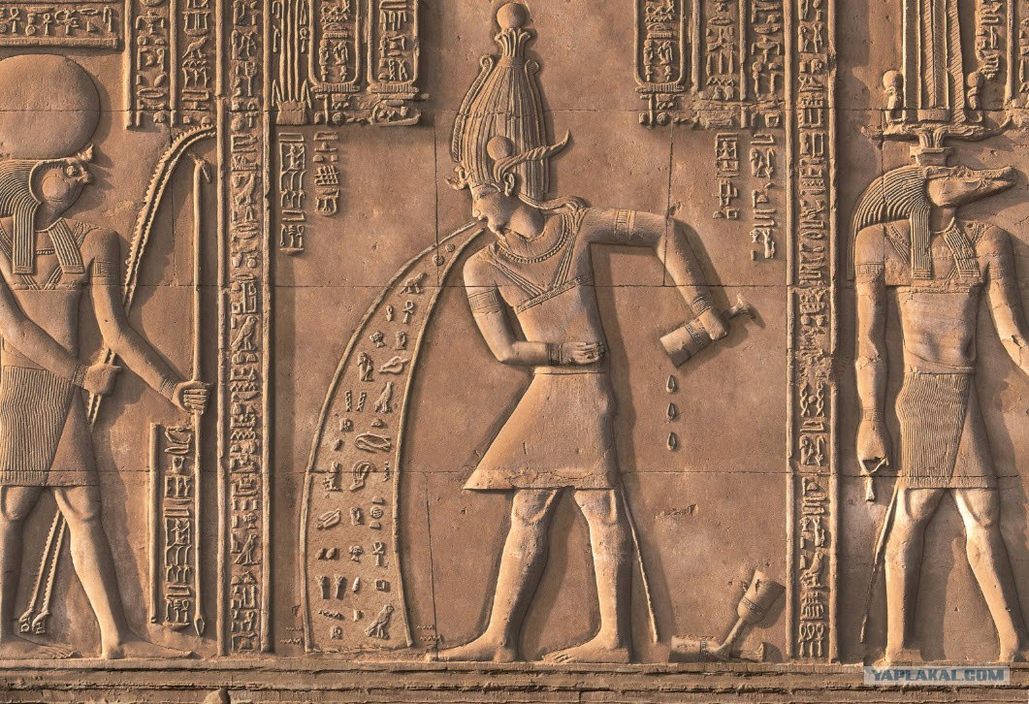
Anthropoemic societies
Anthropoemia = to vomit humans
« … to expel these dreaded beings from the body public by isolating them for a time, or forever, denying them all contact with humanity, in establishments devised for that express purpose. »

Slide 8
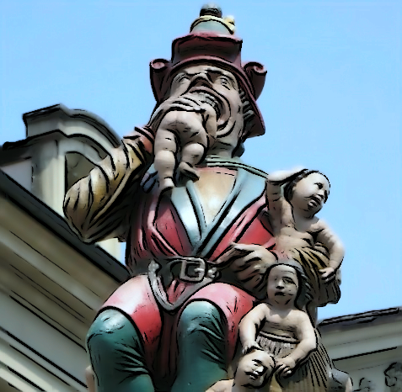
Anthropophagic societies
Those confronted to certain individuals possessing dreaded forces will be absorbed with the aim …
of neutralizing them
of profiting from them

Slide 9
3 types of society
Anthropoemic
encapsulating anthropophagic
to neutralize
assimilating anthropophagic
to profit

Slide 10
Anthropoemic psychiatry
Within the framework of an anthropoemic society
Rejects those who represent a dreaded force out of the social body
those who « out of the usual physiological logic » could put at risk society’s homeostasis
Metaphorically, the toxic element will be vomited
put at distance physically
cut all contacts with normal world

Slide 11
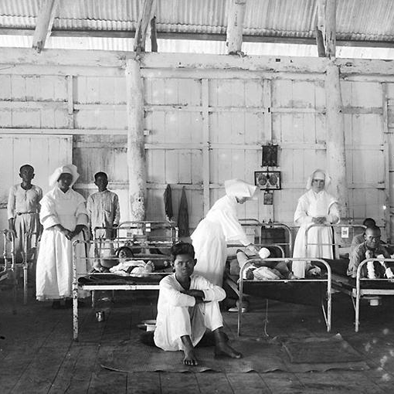
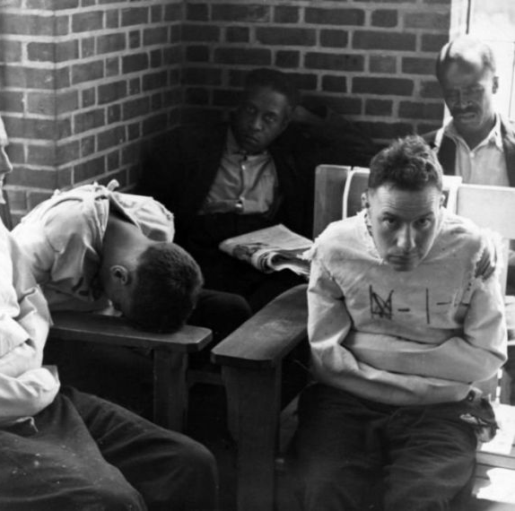
Model
Reproduction
leprous chased from the city
in order not to rotten the flesh of healthy citizens
mad expelled
in order not to infect
with his rotten logic

Slide 12
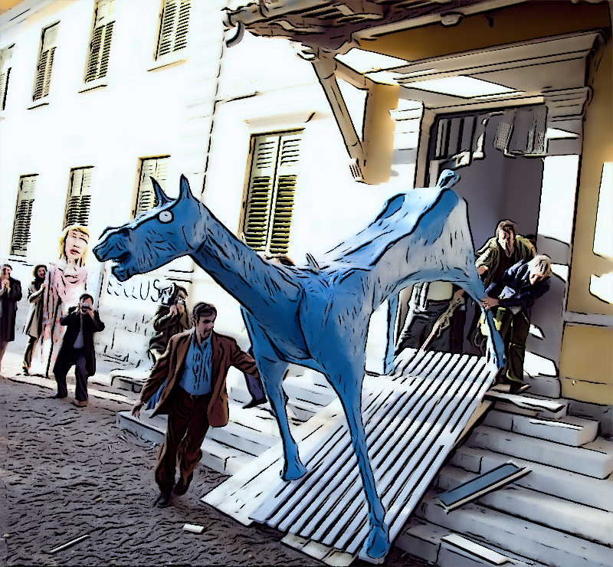
From anthropoemia to anthropophagia
Antipsychiatric and community psychiatry movements ➛ systematic application of anthropoeic model inacceptable
➛ Anthropophagic approach

Slide 13
Encapsulating Anthropophagia
Incorporates the deviant
Confines, restrains, restricts, hogties, conceals, hides in a place inside the society
disjointed from society
in order to neutralize the dreaded forces which call into question normality

Slide 14
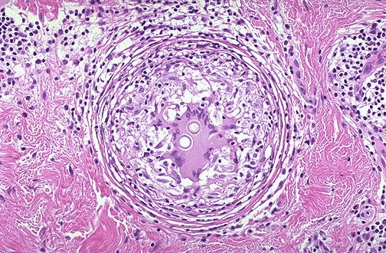
Foreign Body Granuloma

Slide 15
Encapsulating Anthropophagic Psychiatry
Perturbing agent can’t be expulsed or it is to costly to be expulsed
Homeostasis will be saved by encapsulation of the foreign body
Cost-efficacious
System has to function around the encapsulated foreign body

Slide 16
Encapsulating Anthropophagic Psychiatry
➛ therefore necessary to implement the social control logic of the mental asylum (external of the social body) in structures located within the city
Organization of a dispositive with procedures to take off the dreadful forces of normal societal fabric
Organization of an "encapsulating bureaucracy”, as thick and rigid as possible
A social granuloma

Slide 17
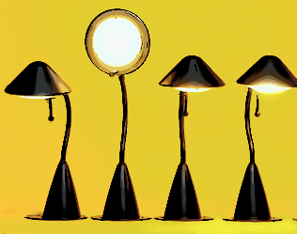
The deviant
For encapsulating system: problem is the "deviant" behavior that puts at risk the society
This behavior can be rationalized, perhaps even explained (by the encapsulating agent)
➛ disease (deviance) is a possession of the physician, of the medicine …. of others
The patient’s experience is at best of secondary interest

Slide 18
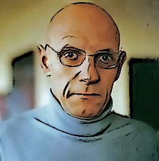
What's a deviant ?
Michel Foucault
… focuses on the economically unproductive man as an enemy of (capitalist) disciplinary society and describes disciplinary institutions (school, factory, hospital ...) as machineries to discipline the non-productive man

Slide 19
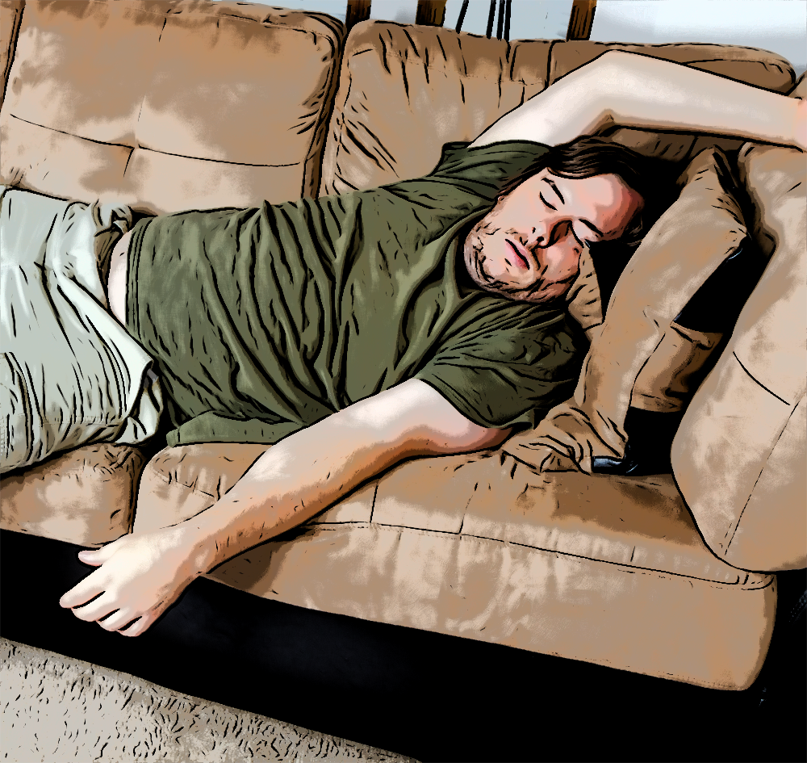
What's a deviant
Jürgen Ruesch, 1972
Deviant = person who does not produce for society
violates the conventions of the time
guilty of infringements of space and properties
improperly uses its own energy (badly distributing them)
mismanaging its finances
ineffective in its productive actions
miscommunication, shifted, "illogical »
➛ almost perfect definition of the »fool" ... but also the "offender" or "slacker »

Slide 20
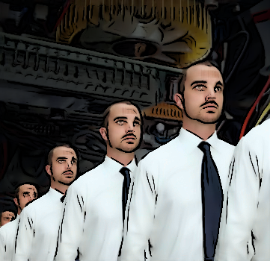
How to treat the deviant
The machine to treat these deviant characters should thus correct this deviation to (re-)make economically productive people
if the recovery in economic productivity is not possible: prevent them from interfering with economic productivity

Slide 21
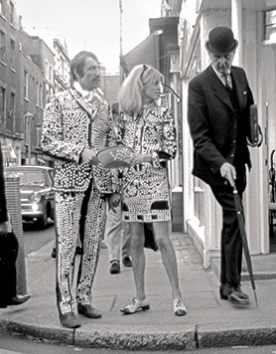
The deviant
No deviant behavior or thought without existing custom
But also, no development, no progress, no evolution without deviation
A deviant is always also somebody who emanates
The deviant is even the origin of any developments
The ability to take advantage of deviance is perhaps the only way to evolve
Deviance is thus in this sense a development opportunity
However: deviance becomes a danger if it exceeds the system's adaptability
Danger of exhaustion, disintegration among others

Slide 22
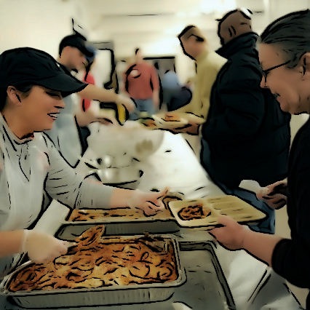
Alternative definition of the deviant
Person who does not participate in the common life
Political participation (voting, electing, being elected, advocating, forming an opinion etc.)
Cultural participation (inspiring oneself, inspiring others, seeking meaning, transmitting meaning)
Civil participation (help, mutual aid, togetherness, welcoming, to welcome etc.)

Slide 23
Alternative definition of the deviant
”Encapsulating" society : does not allow participation
“Assimilating“ society: allows (or even requires) a participation in social, civil, political life
➛ to take advantage of the tension produced by the deviant
What to do with these forces ? How to use them ?
How can what motivated at first exclusion now become (at least in part) an asset ?
What has craziness to offer ?

Slide 24
Assimilating anthropophagic psychiatry
A psychiatry within the social body
geographically, but also regarding the deviant and the normed
Not a psychiatry which rids the normed from the deviant
But: attributes, and even confirms a place and a role to the deviant within the social body
Anthropophagia not to isolate but to incorporate
in order to to take advantage of these formidable forces

Slide 25
Tasks of an anthropophagic psychiatry
To benefit from the deviant
To limit the disruption represented by the madness in order to be assimilable by society
In order to “take advantage of madness”
madness has to be “swallowed” by society (it has to be present)
it has to interfere with the normal, has to destabilize it
it is moderated (e.g. by psychiatry)

Slide 26
convention
standard
custom
convenance
Artist
Genius
Fatuous, corny,
meaningless, vacuous,
inane, silly….
inconsiderable
worthless
Nutty, erratic, bizarre,
meaningless, vacuous,
inane, silly….
inconsiderable
worthless
tolerance
zone

Slide 27
Tasks of an anthropophagic psychiatry
Organize interferences between society and the deviant
Similarly to interaction between artists and society
Artist produces deviances that are strong enough to trigger the revival through assimilation in the society without overstraining
If he succeeds his artistic enterprise, he is original
If it exceeds the public’s assimilation capacity, if the starting distance between convenient logic and the logic of his work is too important, he will be absurd, inane, stupid ... not to consider, to deny, to exclude

Slide 28
Transition to an assimilating system
vision change
isolating a deviance
keeping deviance and
normality separated
advocating interactions
between otherness and
normality

Slide 29
Society
Art Business
Gallerists, curators, critics
etc.
Psychiatry
Psychiatrists, nurses,
psychologists, social workers
etc
Artist
Patient

Slide 30
Working methods of the assimilating anthropophagic psychiatry
Has to develop possible selves for patients (but also for the institution itself) around the principle of civic participation rather than around the social integration precept
Should rather be a creative, generative, designing, innovative institution than a conservative institution which is guardian of conventions, librarian of deviance
For this it must obviously question its role as guardian of the order

Slide 31
Assimilating anthropophagic psychiatry should be artistic
Artist = persona that builds on agreements in order to divert them, to unwrap them, deploy them … go beyond
Assimilating anthropophagic psychiatry should be based on conventions (accepting them as given) … to go beyond

Slide 32
Transition to an assimilating system
asylium model
assimilating model
Patient observed in an
artificial spatial-temporal
context
(in vitro)
amputated from his original
context
accompanied within
his situation (in vivo)
discontinuity between
life and disease
continuity of a life path

Slide 33
Encapsulating
Anthrophagia
Assimilating
Anthropoemia
Anthropoemia

Slide 34
http://addictohug.ch/
https://www.facebook.com/addictologieHUG/
https://twitter.com/addictologiehug
https://www.linkedin.com/company/service-d'addictologie
https://www.youtube.com/channel/UCVhK2ZmXqSqWqR3rtgGHvpA/videos
http://www.hug-ge.ch/addictologie

