Slide 1
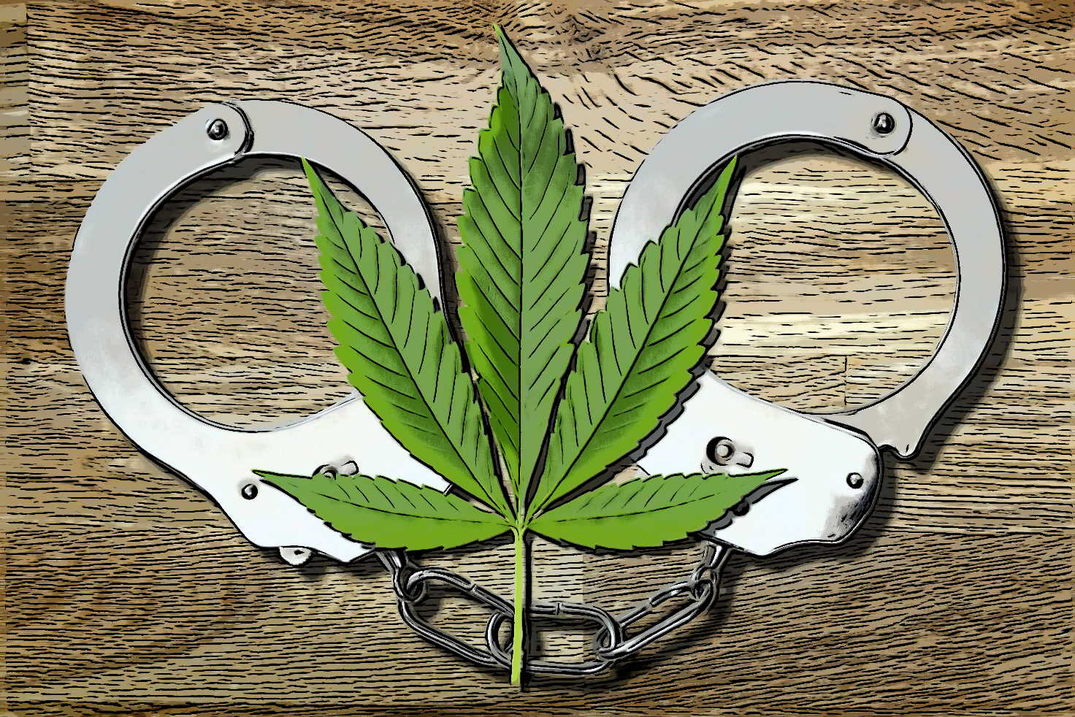
Can the cannabis-prohibition be supported by medical evidence?
Prof. Dr. med. Daniele Zullino
WHO collaborating center

Slide 2
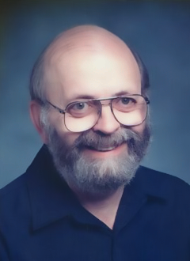
The Moral Limits of the Criminal Law
Vol. 1, Harm to Others
Vol. 2, Offense to Others
Vol. 3, Harm to Self
Vol. 4, Harmless Wrongdoing
Joel Feinberg
1926 - 2004
Notes:
Joel Feinberg (October 19, 1926 - March 29, 2004) was an American political and social philosopher

Slide 3
Underpinnings of legal interdictions
Harm
Offense
Immorality
against
others
against
oneself
against
others
against
oneself
against
morality

Slide 4
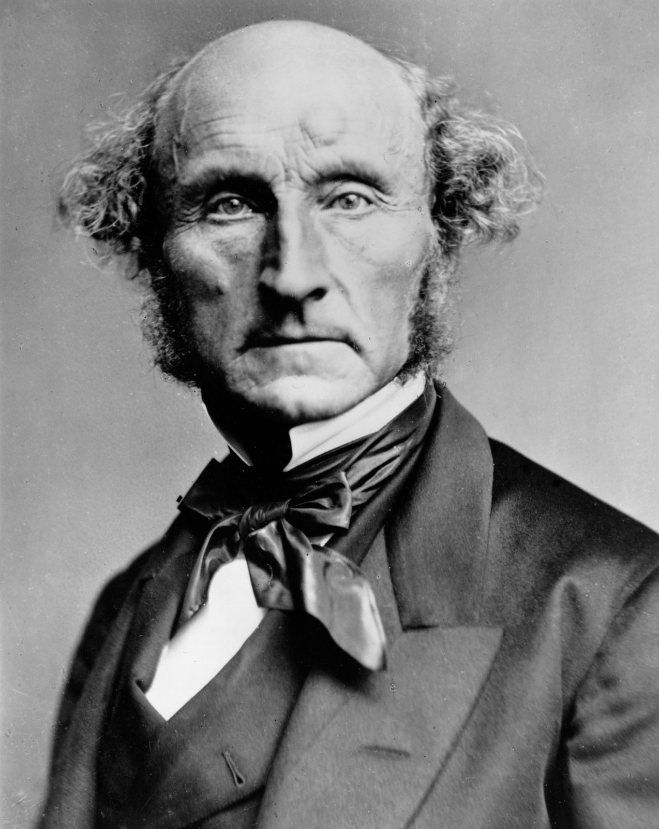
Harm Principle
"The only purpose for which power can be rightfully exercised over any member of a civilized community, against his will, is to prevent harm to others."
John Stuart Mill
1806 - 1873
Notes:
John Stuart Mill (20 mai 1806 à Londres - 8 mai 1873 à Avignon, France) est un philosophe et économiste britannique

Slide 5
Cannabis
Medical Harm
Question 1
Does cannabis cause harm?
CAUSALITY

Slide 6
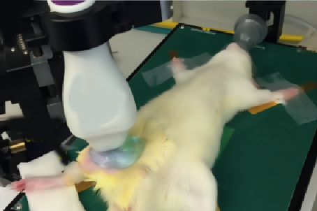
Cannabis passive smoking harms ?
Flow-mediated dilation (FMD) : extent to which arteries vasodilate in response to increased blood flow
1 min. exposure to marijuana secondhand smoke impaired femoral artery FMD comparable to tobacco smoke
Recovery considerably slower
Wang et al., 2016

Slide 7
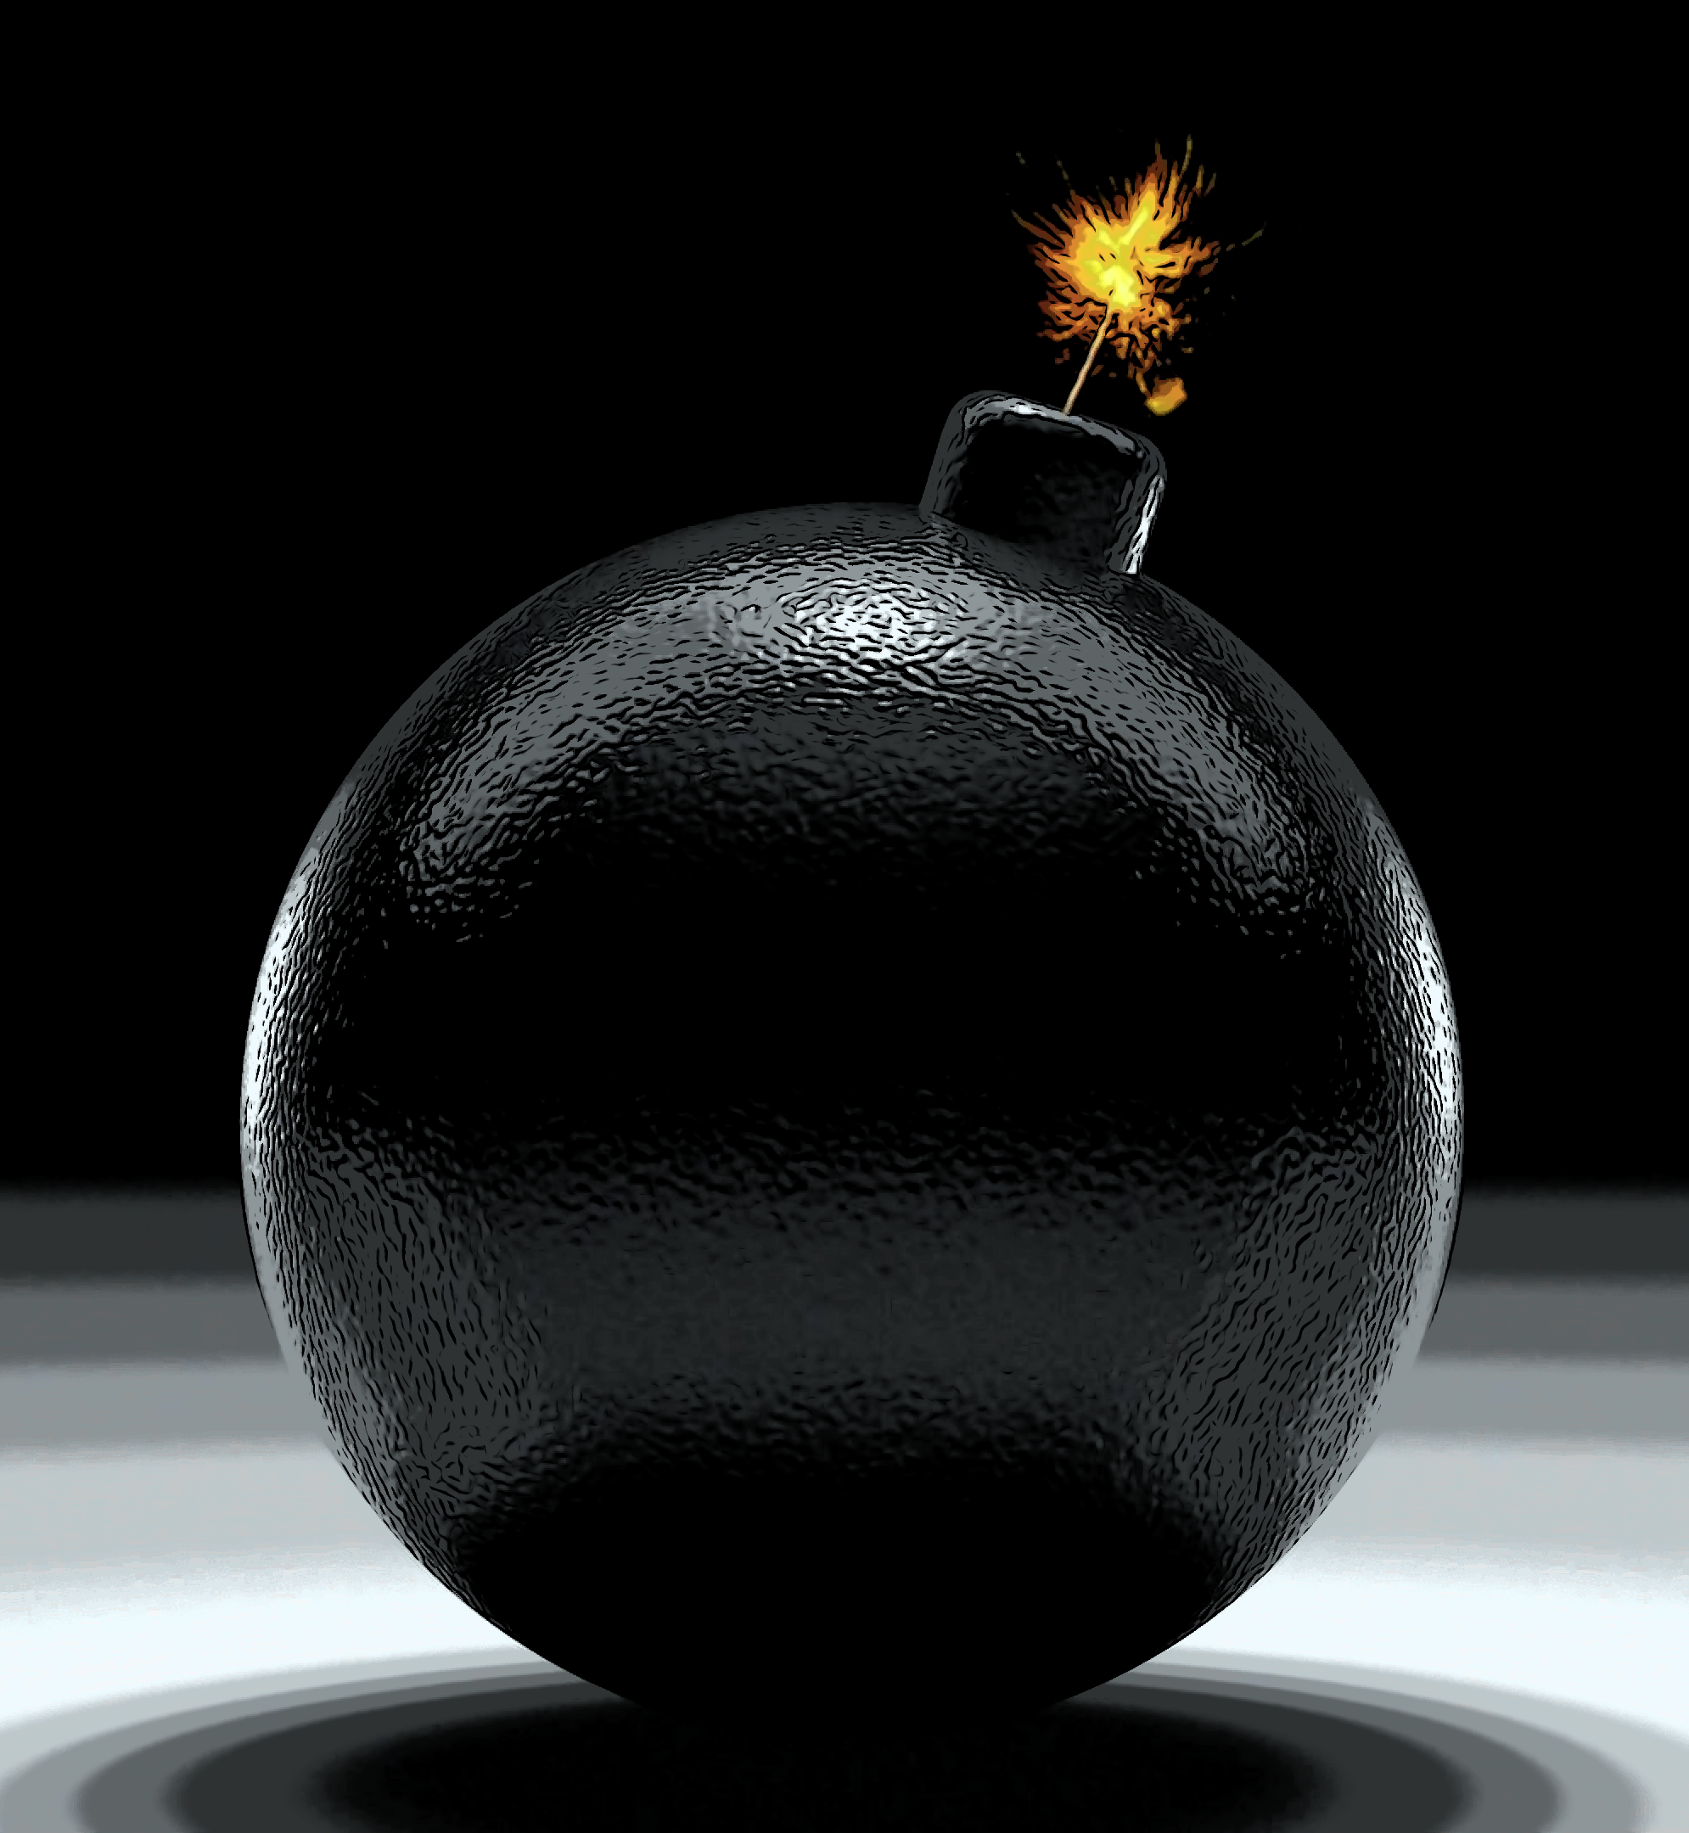
Other possible harms
Health costs imposed by consumers on the community
Health-related and intoxication-related productivity loss
Crash fatalities

Slide 8
Effects on traffic
No correlation between regulation and crash rates
Significant ↓ in opioid positivity for drivers 21–40 years old
Significant ↓ fatally injured drivers
DUI arrests for driving under the influence, of alcohol and other drugs, have declined in Colorado and Washington
Crash rates in both states have remained similar to those in comparable states that have not legalized marijuana.
Kim et al., 2016; Drug Policy Alliance 2016

Slide 9
Question 2
Can prohibition prevent harm?
USEFULNESS
Question 3
Is there an alternative to prohibition?
NECESSITY
Cannabis
Medical Harm
Question 1
Does cannabis cause harm?
CAUSALITY

Slide 10
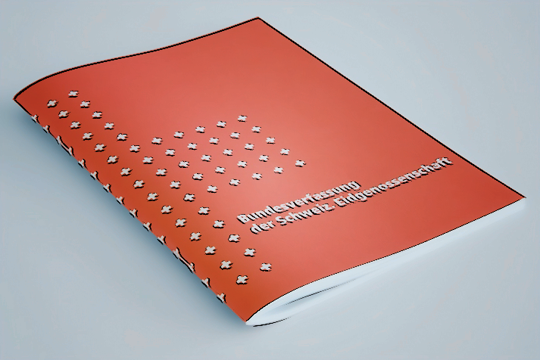
Swiss Constitution
Art. 36 Restrictions on fundamental rights
1 … must have a legal basis
2 … must be justified in the public interest
3 … must be proportionate.

Slide 11
Evidence-based
Laws
Charge of prove
among prohibitionnists !
Restrictions
of freedom
Harm

Slide 12
Charge of prove
among reformists !
Current
prohibition
Restrictions
of freedom
Harm

Slide 13
Underpinnings of legal interdictions
Harm
Offense
Immorality
against
others
against
oneself
against
others
against
oneself
against
morality

Slide 14
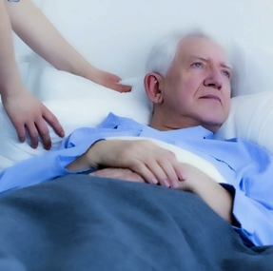
Paternalism
Special form of limitation of freedom
Beneficience by hétéro-détermination
Trying to do good to people
… even without their consent
… possibly against their will

Slide 15
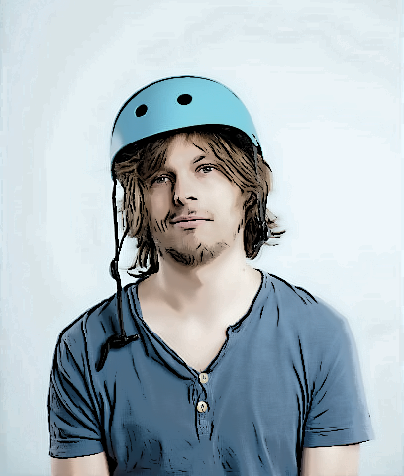
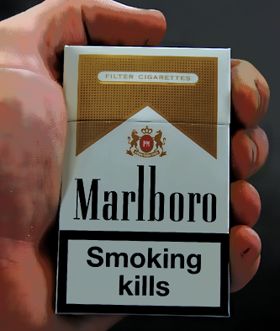
Hard paternalism
Soft paternalism
Always forbidden and pursued
Forbidden if no consent capacity
(Majority? Risk information?)

Slide 16
Hard paternalism
to consent to harm oneself ist "inherently irrational »
 to consent to suffering is inacceptable
citizens not sufficiently motivated inform themselves

Slide 17
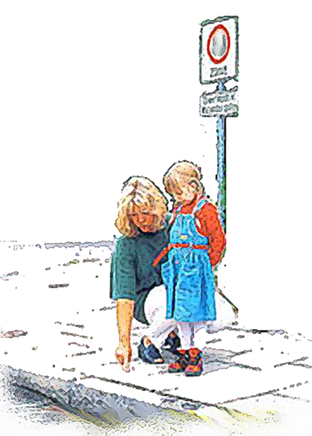
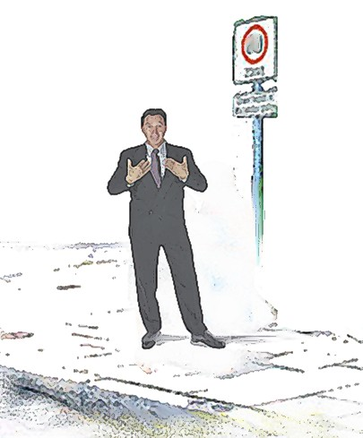
Paternalism and protection vulnerable subjects
Forbidden because no capacity of discernment
Forbidden because someone else has no capacitiy of discernment

Slide 18
Question 2
Can prohibition prevent harm?
USEFULNESS
Question 3
Is there an alternative to prohibition?
NECESSITY
Cannabis
Medical Harm
Question 1
Does cannabis cause harm?

Slide 19
Precautionary Principle
In the case of serious or irreversible threats to human health, acknowledged scientific uncertainty should not be used as a reason to postpone preventive measures
Until more complete / conclusive evidence is available ➛ critical to make decisions based on the best existing evidence
Shift of the burden of proof to the proponents of an activity

Slide 20
Preventive
Interventions
Precautionary
Interventions
already identified and scientifically corroborated hazards
^{uncertain risks}
strategic shift
CAUTION
PRECAUTION

Slide 21
Two Categories of Uncertainty
Uncertainty about the causal relationship
Uncertainty about the risk of consequences
Precautionary principle actually concerns second category
Regarding cannabis and its consequnces, the uncertainty almost exclusively concerns the first category
E.g. Elimination of cannabis use would reduce the incidence of schizophrenia by approximately 8% ... assuming a causal relationship

Slide 22
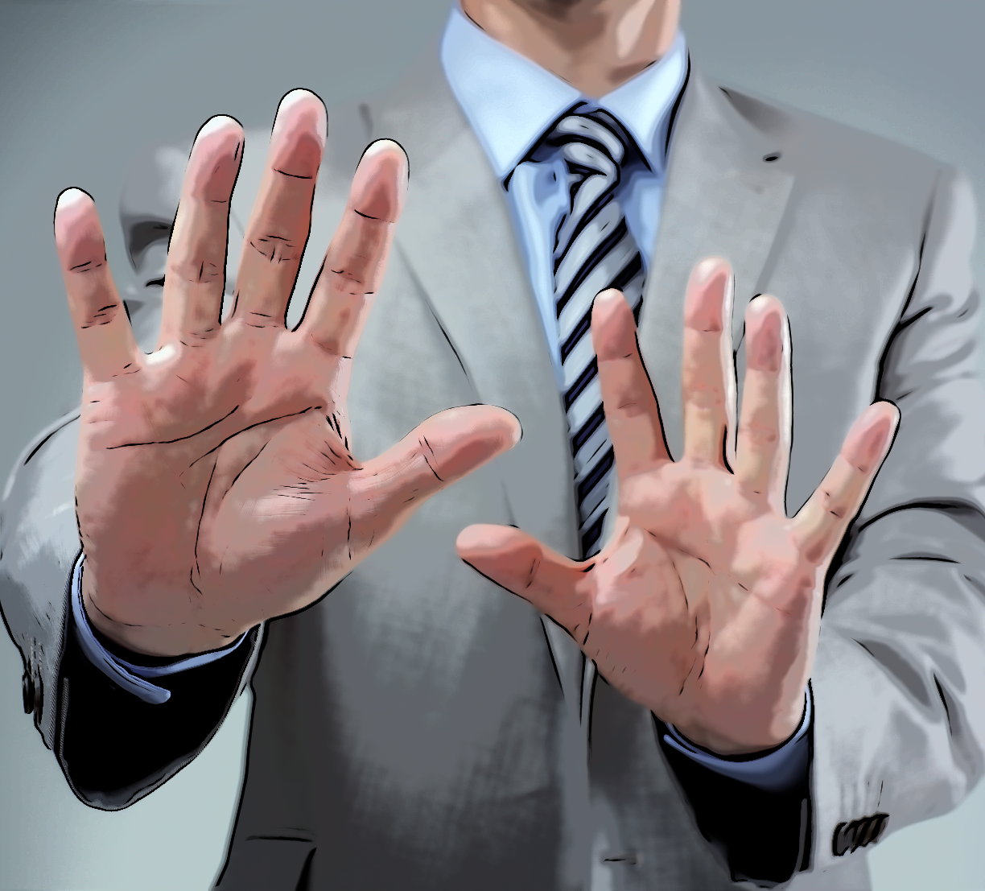
Precautionary avoidance of risk ?
Precautionary actions ➛ reducing / removing exposures to potential risk
Exposure to the potential cannabis-risk is already high !!
Argument that prohibition allowed limiting further risks/harms

Slide 23
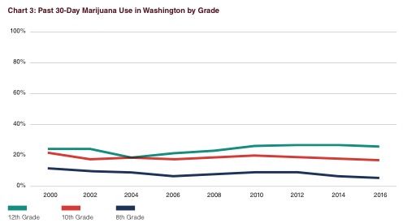
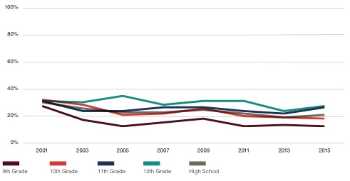
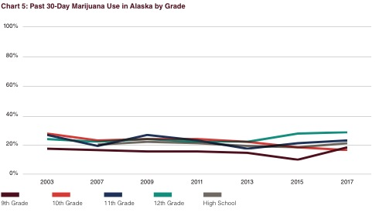
Washington State Healthy Youth Survey
Healthy Kids Colorado Survey
Alaska Youth Risk Behavior Survey
Healthy Youth Survey 2016 Analytic Report; Drug Policy Alliance 2018; Data Brief: Substance Use Overview,” Washington State Department of Social and Health Services, Department of Health, Office of the Superintendent of Public Instruction, and Liquor and Cannabis Board, 2017;
Drug Policy Alliance 2018; Alaska Youth Risk Behavor Survey Results, ”Alaska Department of Health and Social Services,
Division of Public Healt, 2017

Slide 24
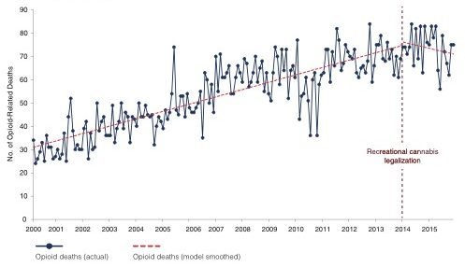
Monthly Opioid-Related Deaths
Colorado
Livingston et al., 2017

Slide 25
WHO
Relevant measures to consider when applying the precautionary principle
To replace dangerous substances and activities with less dangerous substances and practices where suitable alternatives are available
To reconsider production processes, products and human activities so as to minimize significant adverse effects on health and the environment
To establish public health goals
To provide information and education to the public to promote empowerment and accountability
To minimize, so far as possible, unintended adverse consequences that may be caused by precautionary actions
Martuzzi & Tickner, 2004

Slide 26
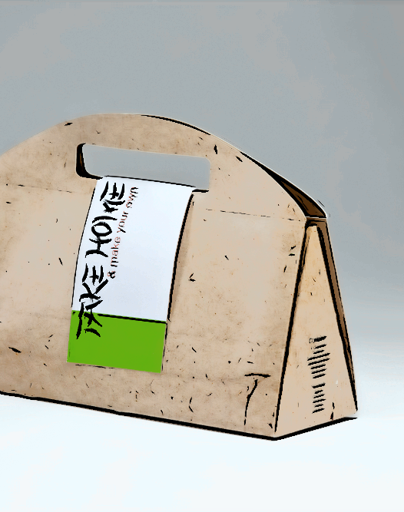
Conclusions
Harm principle: for preventive or for precautionary reasons, prohibition not justified
Legal paternalism: for preventive or for precautionary reasons, prohibition not justified
Regulated market appears to be the more suitable approach compared to prohibition
Another legal principle has thus to apply in order to maintain prohibition

Slide 27
http://addictohug.ch/
https://www.facebook.com/addictologieHUG/
https://twitter.com/addictologiehug
https://www.linkedin.com/company/service-d'addictologie
https://www.youtube.com/channel/UCVhK2ZmXqSqWqR3rtgGHvpA/videos
http://www.hug-ge.ch/addictologie

